Slide 1
InsurAI – Corporate Policy Automation and Intelligence System

Slide 2
Abstract
This project is a comprehensive Employee Loan Management Portal designed to create a secure and efficient digital platform for both employees and administrators. It allows employees to apply for various loan products by submitting detailed forms and uploading required supporting documents through a user-friendly interface. For administrators, the portal provides a separate, secure dashboard where they can manage the entire process. They can search for applications, review submitted details, verify documents, and approve loans by updating key financial information. This system streamlines the complete workflow from the initial application to the final approval. To enhance the user experience, an integrated chatbot is included to provide instant support and answer frequently asked questions about the loan process.

Slide 3
Proposed System
Separate logins and dashboards for Employees and Administrators.
Employees can apply for loans by filling out forms and uploading documents.
Admins can search, review applications, and download documents via their dashboard.
Admins approve loans by updating them with EMI and installment details.
Employees can track the status of their loan application ('Pending' or 'Approved’).
An integrated chatbot assists users with frequently asked questions.

Slide 4
Technology Stack
Front-End:
JavaScript Library/Framework: React.js
Routing: React Router is used for client-side navigation within the application.
Back-End:
Runtime Environment: Node.js
Web Framework:Express.js
Middleware:
CORS: Used to enable Cross-Origin Resource Sharing.
Multer:Used for handling multipart/form-data, primarily for file uploads.

Slide 5
Technology Stack
Database:
Database System: MongoDB
ODM (Object Data Modeling) Library: Mongoose is used to model and interact with the MongoDB database.

Slide 6
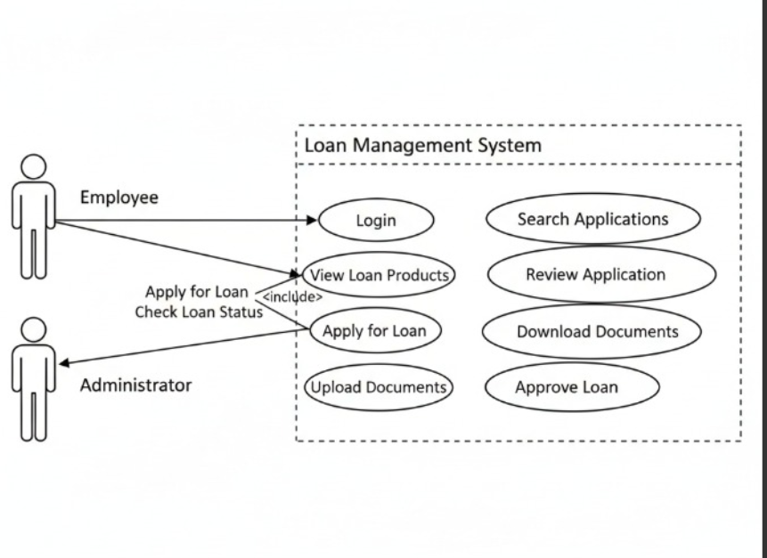
Use Case Diagram

Slide 7
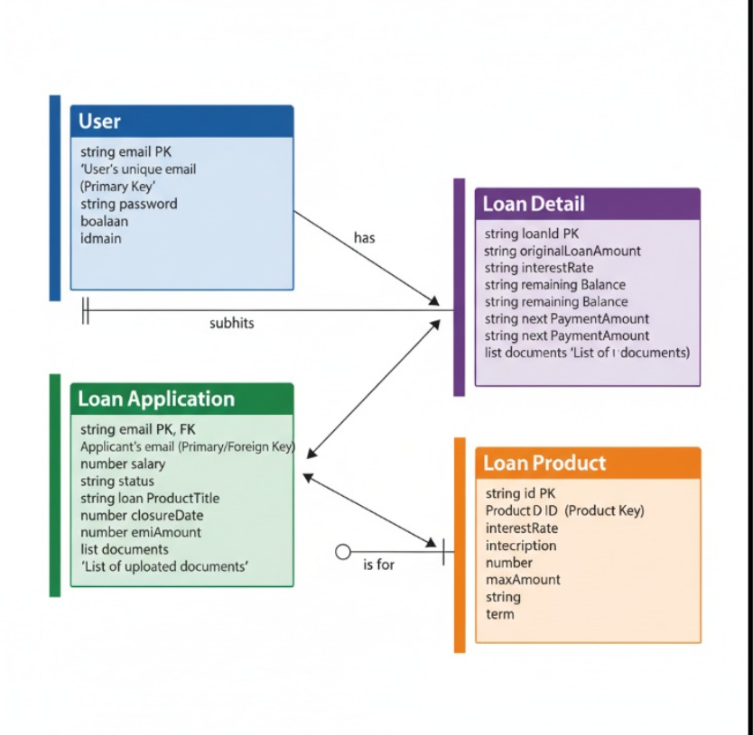
ER Diagram

Slide 8
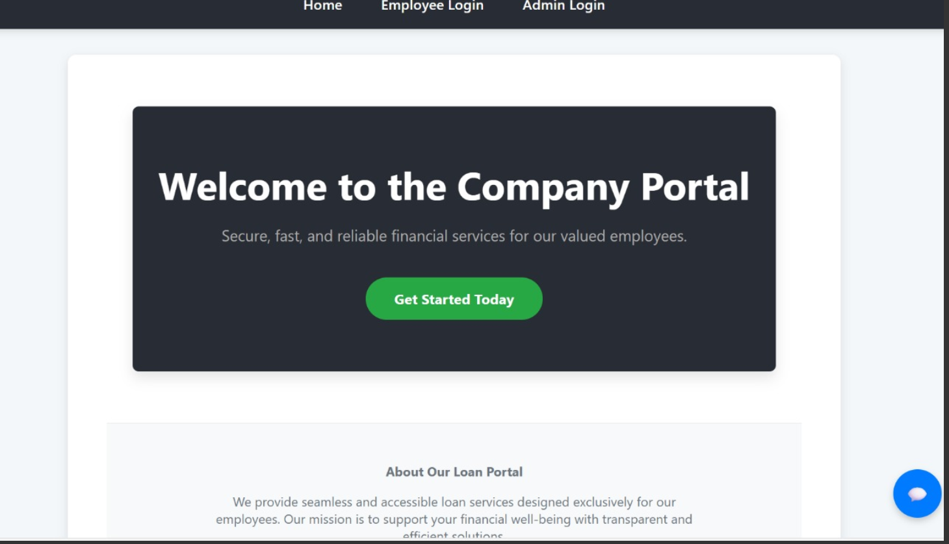
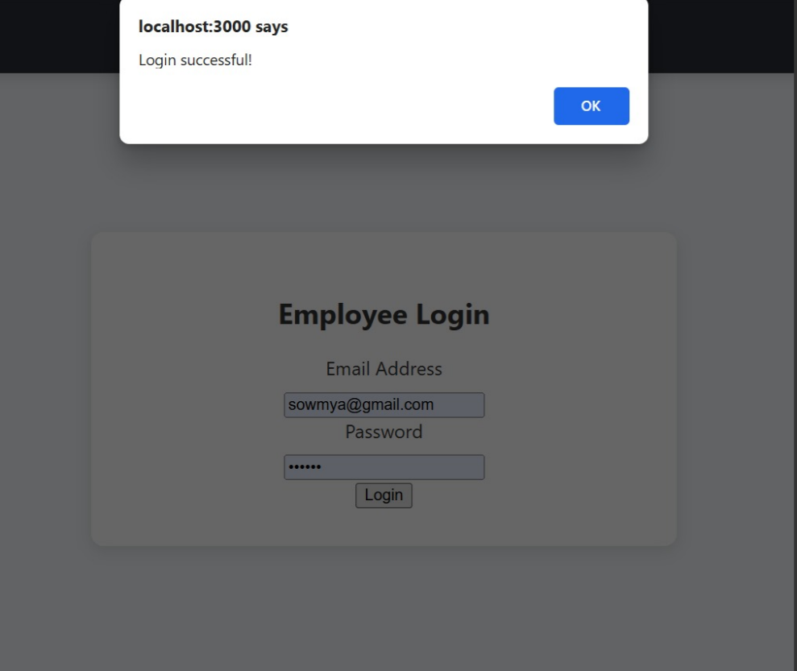
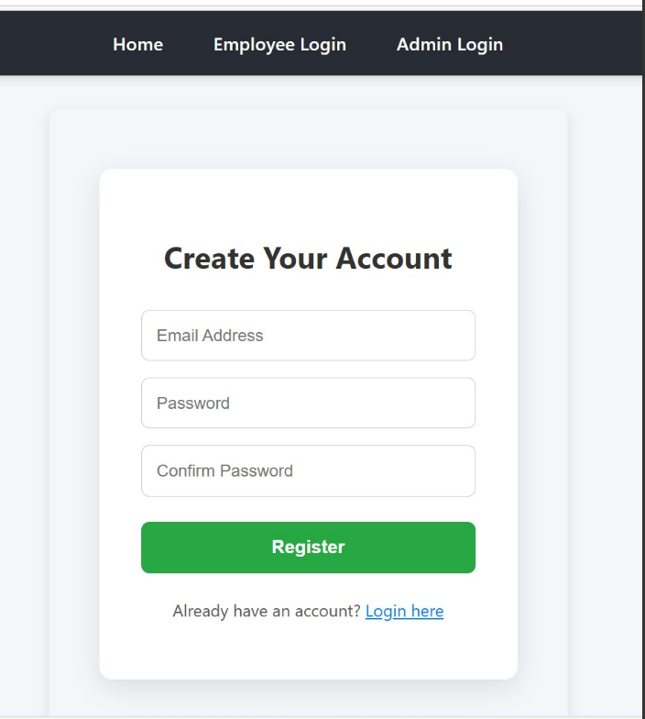
Project Visuals

Slide 9
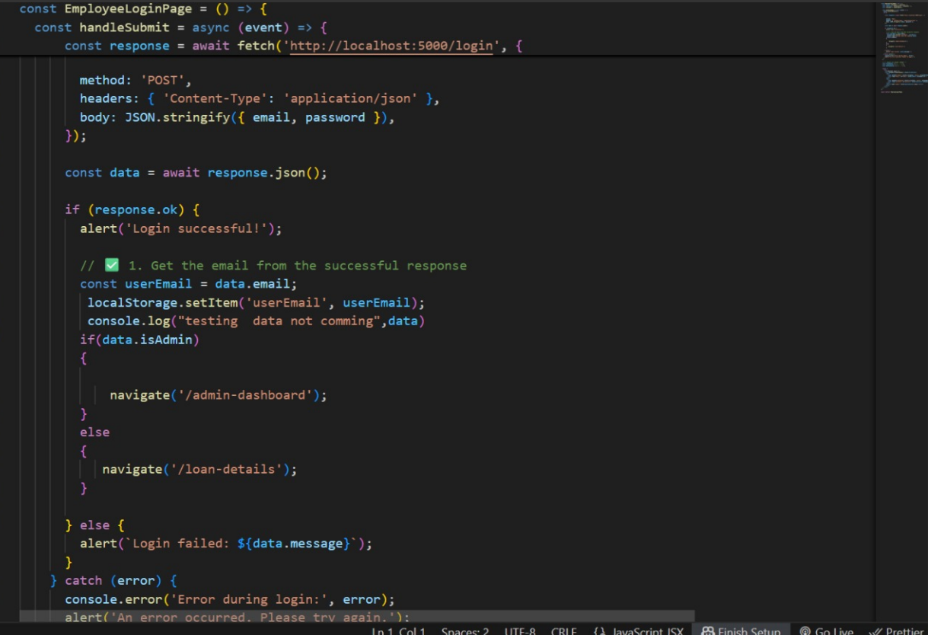
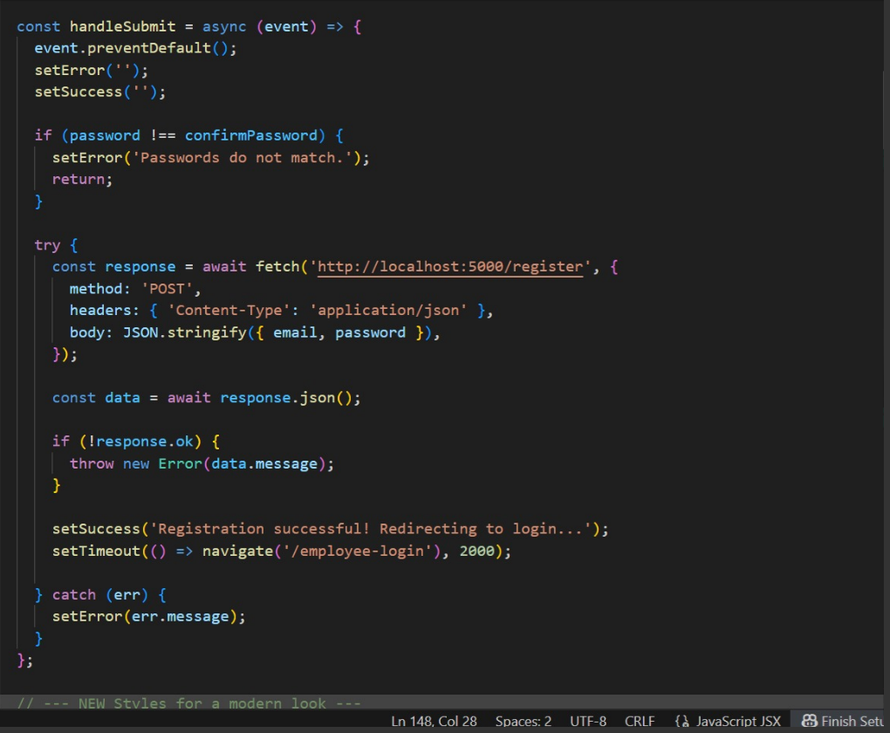
User Model

Slide 10
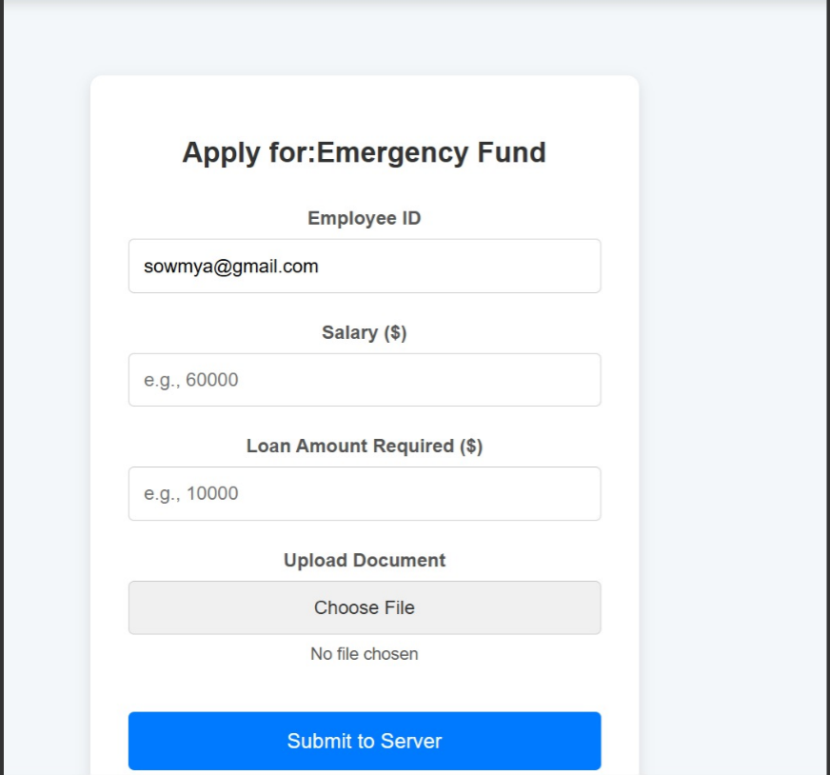
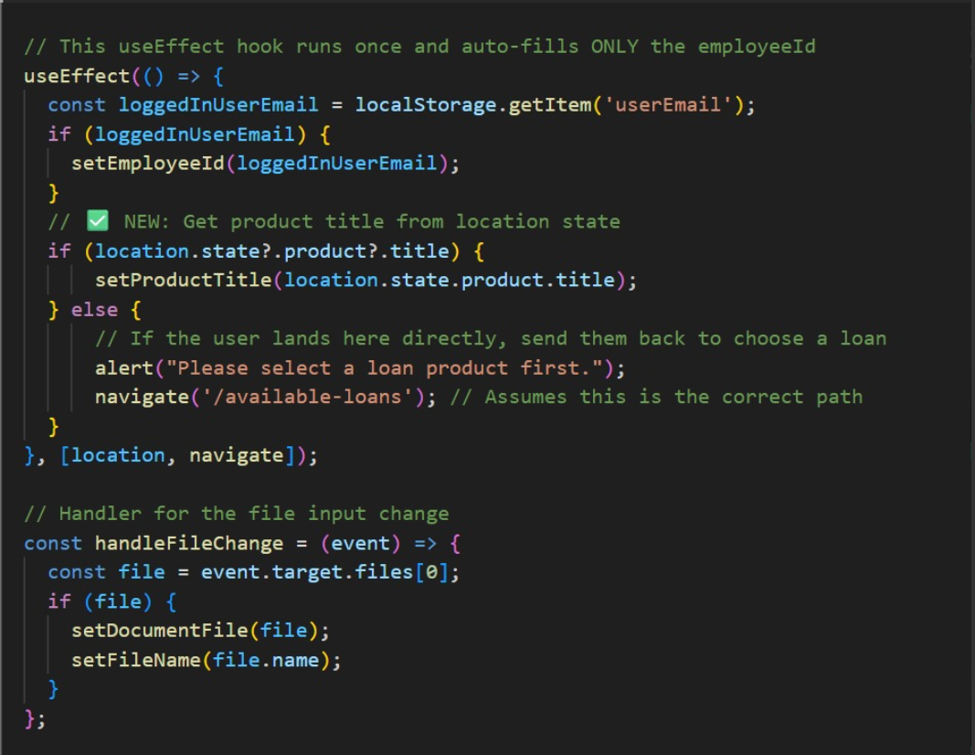
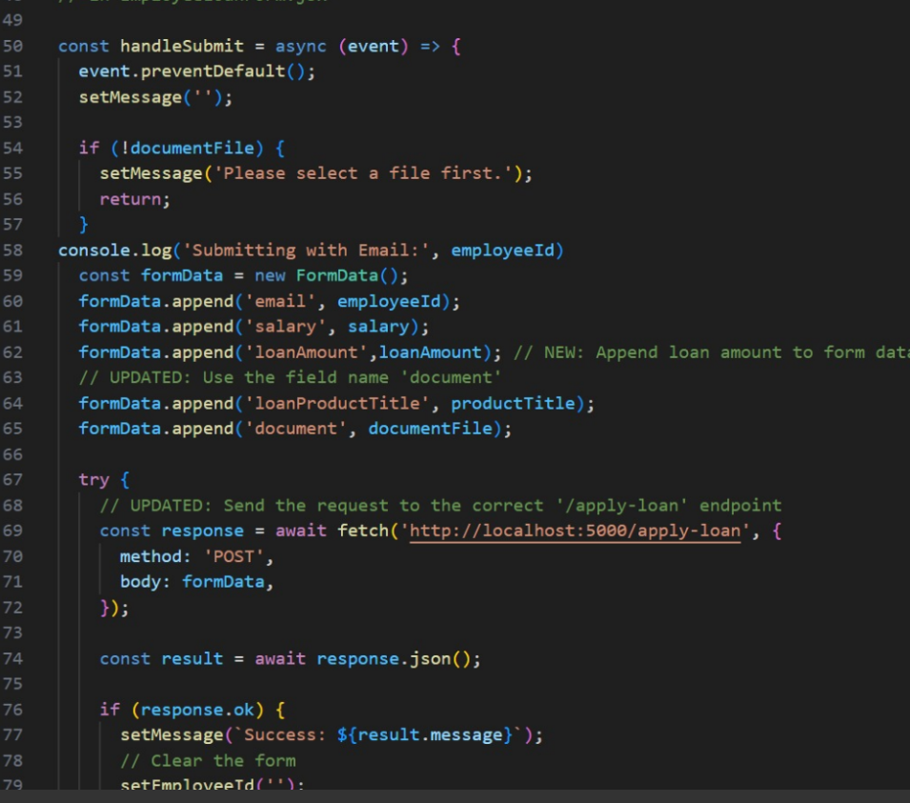
Employee Loan Form

Slide 11
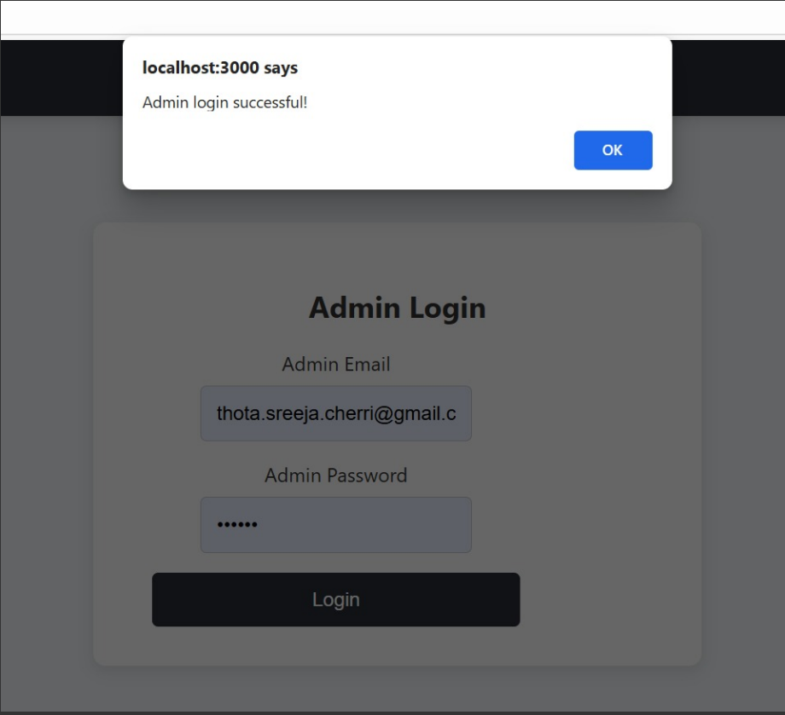
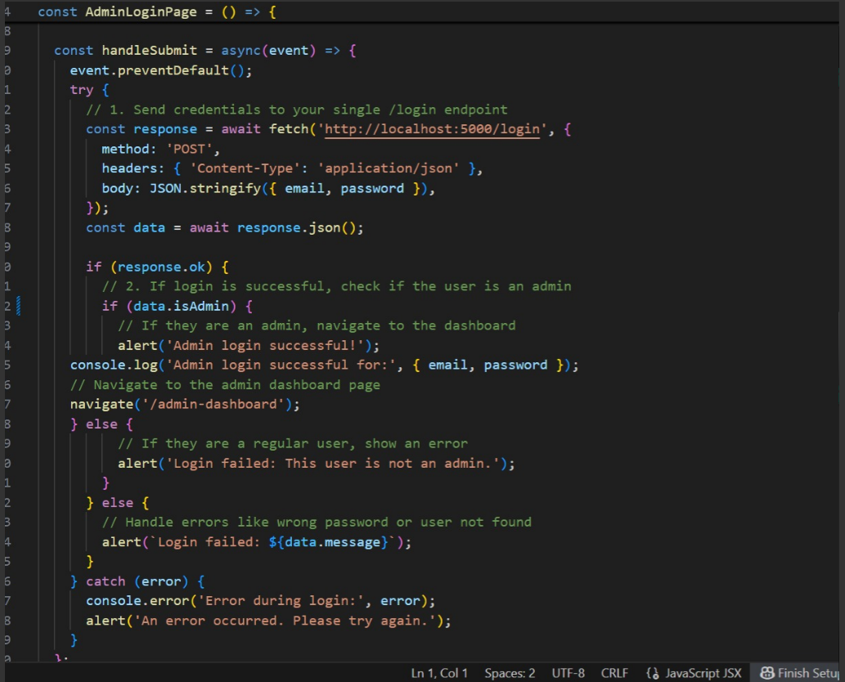
Admin Login Page

Slide 12
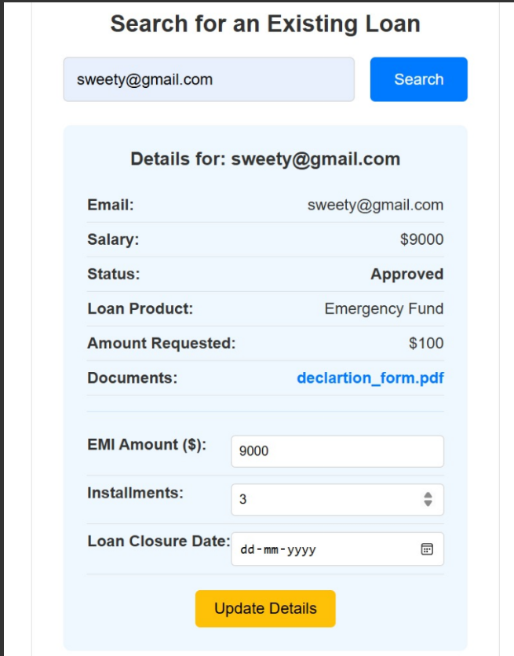
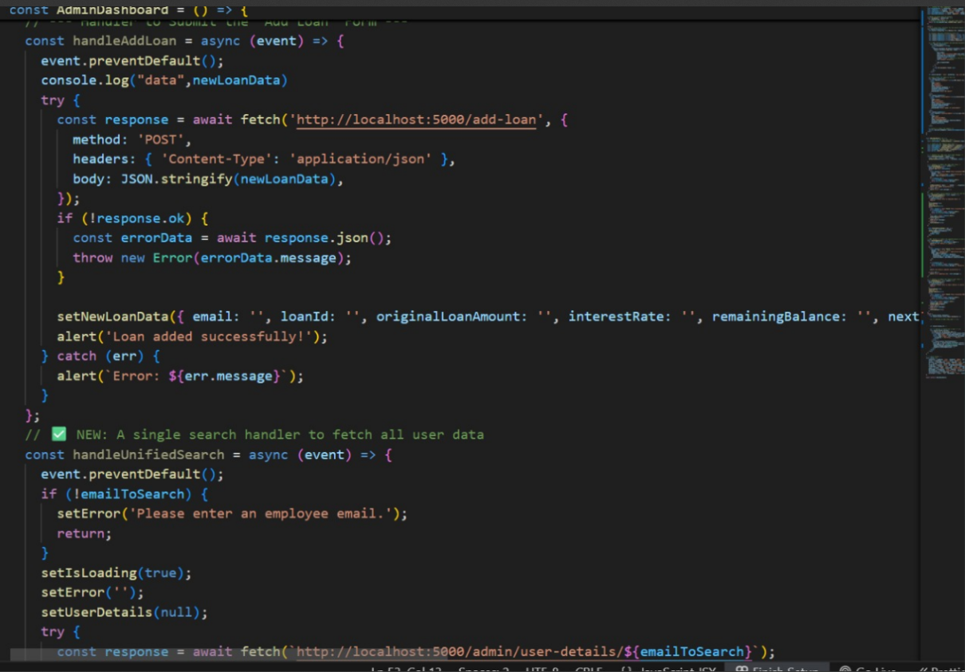
Admin Dashboard

Slide 13
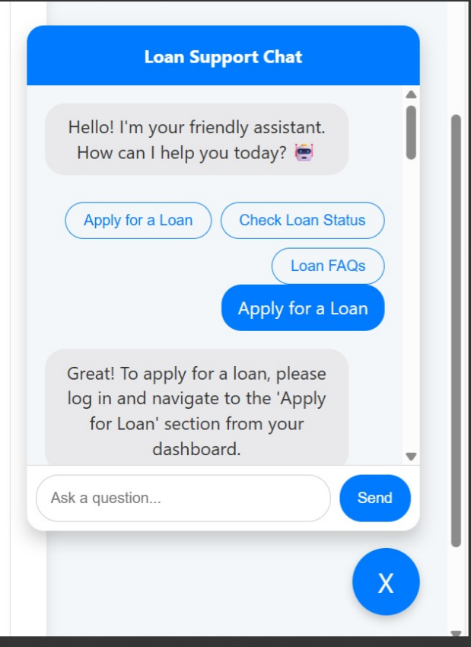
ChatBot

